Slide 1
Paper
Code
DeMuX: Data-efficient Multilingual Learning
Simran Khanuja, Srinivas Gowriraj, Lucio Dery, Graham Neubig Paper: https://arxiv.org/pdf/2311.06379 Code: https://github.com/simran-khanuja/demux
Notes:
Main title: 40 pt. Arial
Presenter Name: 16 pt. Arial
Presenters Title: 16 pt. Arial Italic

Slide 2
Problem Statement: A Story
Hindi
Hindi
Bengali
Bengali
Tamil
Tamil
Marathi
Marathi
Kannada
Kannada
Logo generated using DALL-E 3

Slide 3
Problem Statement: A Story
Hindi
Hindi
Bengali
Bengali
Tamil
Tamil
Marathi
Marathi
Kannada
Kannada
Logo generated using DALL-E 3

Slide 4
Problem Statement: A Story
Hindi
Hindi
Bengali
Bengali
Tamil
Tamil
Marathi
Marathi
Kannada
Kannada
UNK
❓
❓
UNK
UNK
UNK
Logo generated using DALL-E 3

Slide 5
Problem Statement: A Story
UNK
UNK
UNK
UNK
Step 1: Language Identification (LID) Commercial language identification systems fail to identify 98% of the world’s languages¹
❌
¹This was true of Google Cloud's LangID as of December 2023: https://developers.google.com/ml-kit/language/identification/langid-support

Slide 6
Problem Statement: A Story
Dzongkha
Dzongkha
Tharu
Tharu
Step 1: Language Identification Human intervention
✅
Step 2: Annotator Availability Crowdsourcing platforms’ lack of support¹
❌
¹Here, we use mturk as a proxy to make this claim.

Slide 7
Problem Statement: A Story
Dzongkha
Dzongkha
Tharu
Tharu
Step 1: Language Identification Human intervention
✅
Step 2: Annotator Availability Identify languages where annotators are available
✅
Step 3: Transfer Languages Missing linguistic feature information/model performance¹
❌
¹e.g. in the WALS database: https://wals.info/languoid

Slide 8
Problem Statement: A Story
Nepali
Dzongkha
Tibetan
Tharu
Step 1: Language Identification Human intervention
✅
Step 2: Annotator Availability Identify languages where annotators are available
✅
Step 3: Transfer Languages Human Intervention
✅
Step 4: Data Annotation How do we select in-domain data from multiple sources, under an annotation budget?
❌

Slide 9
Main Research Question
How do we select the exact data points to give to annotators for best performance in their domain and target languages, under a fixed budget, from a multilingual data pool, given a pre-trained multilingual model?

Slide 10
Unlike past methods, DeMuX works with…
No Language Identification
✅
No Linguistic feature information
✅
No past-model performances
✅
Disjoint source and target sets
✅
Target Data
Source Data
Models
A
Labelling
B
C

Slide 11
Some other benefits
Gives exact data points to label from across multiple languages, instead of choosing a few best transfer languages
Selected data differs across tasks for the same target language, providing insights into task-specific cross-lingual transfer
Works with multiple target language pools
Works with very limited annotation budget (10-50 samples)

Slide 12
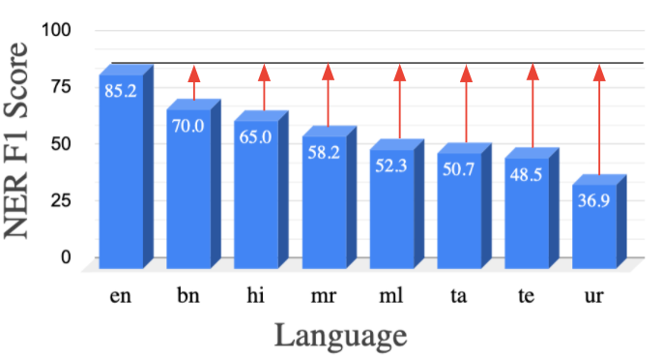
Background on multilingual fine-tuning
Given the lack of annotated data in non-English languages, most works previously focused on zero-shot cross lingual transfer from English
[Lauscher et. al]:
Transfer performance is a reflection of source languages
Small amounts of in-language training data gives huge boosts in performance

Slide 13
Background on active learning
Inform annotation efforts by using model representations
Two major considerations for data selection :
Diversity
[In-domain target] Diverse representation of source
[OOD]: + Selecting points that are close to target points
Uncertainty
Selecting the most uncertain points in each AL round increases robustness of decision boundary
Hybrid
An “optimal” combination of the two

Slide 14
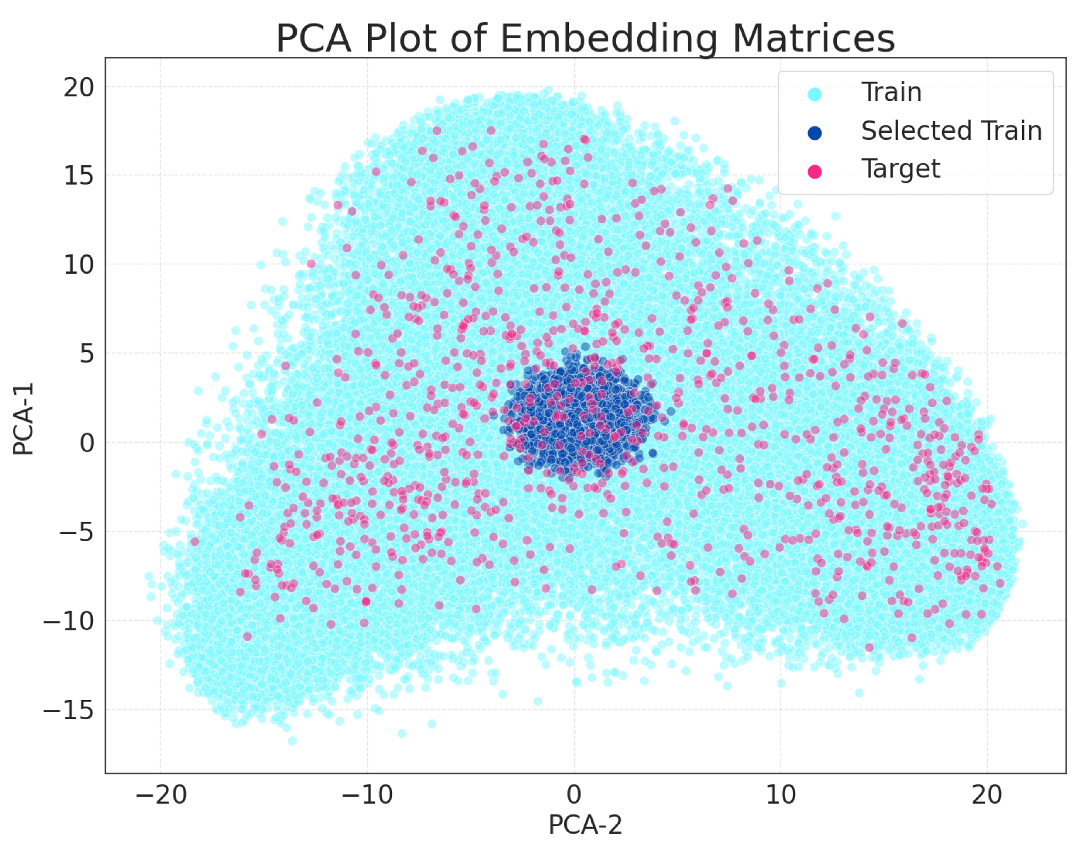
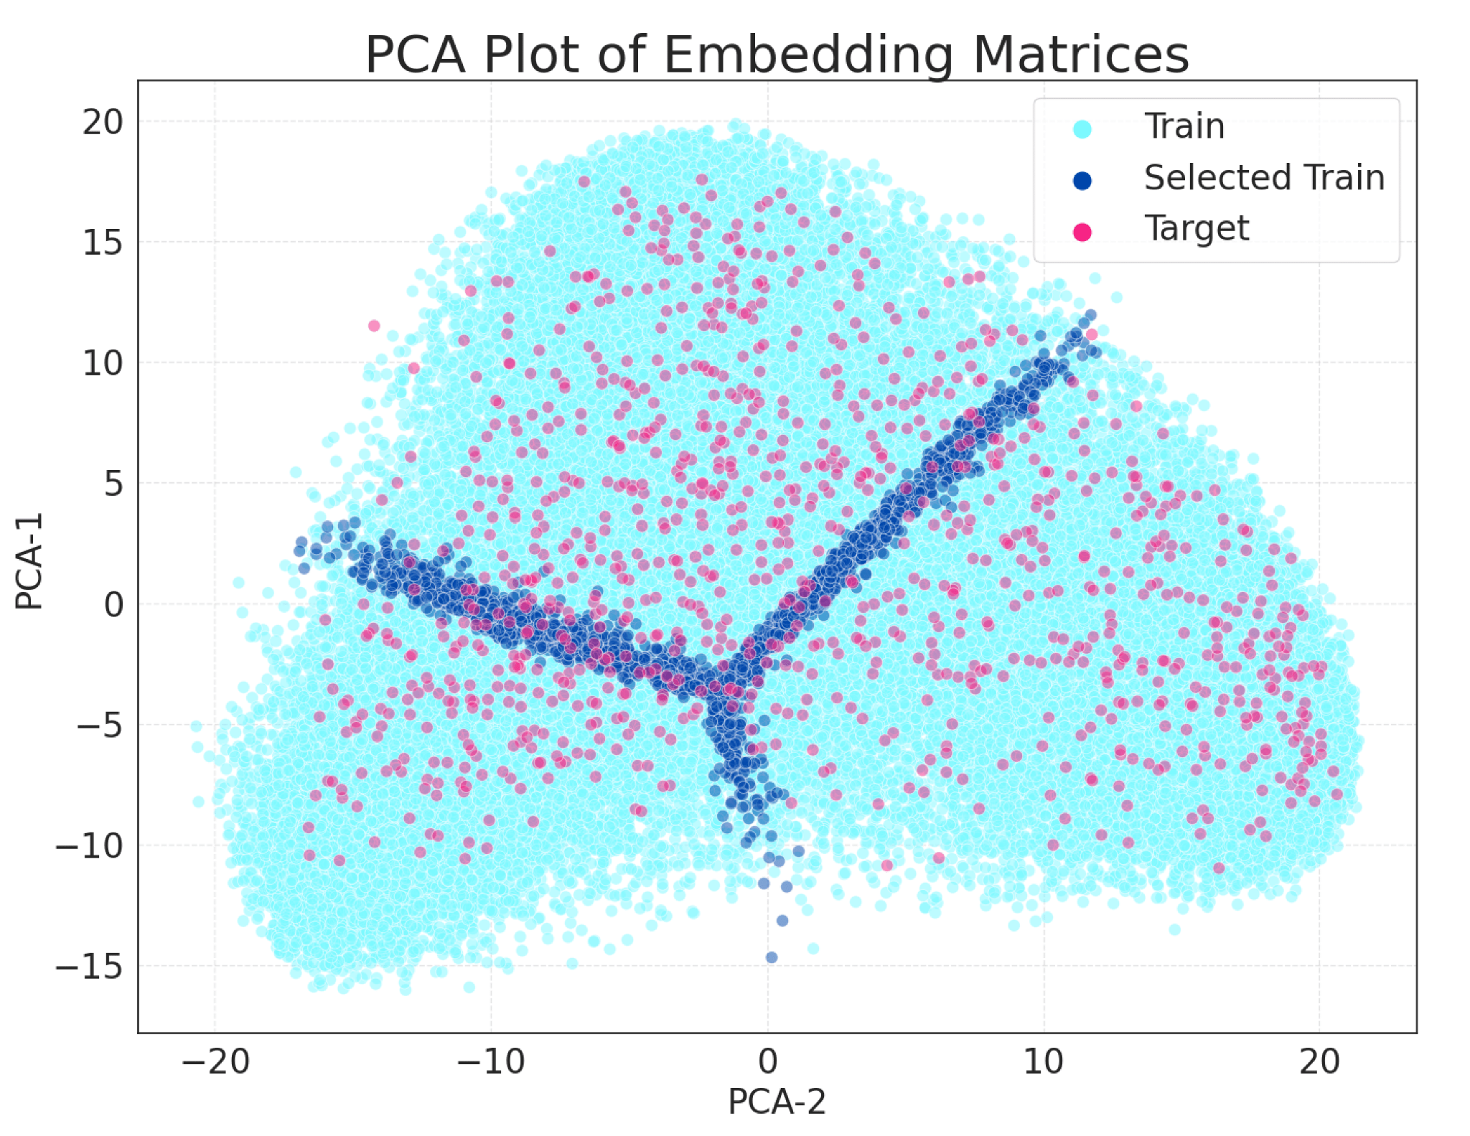
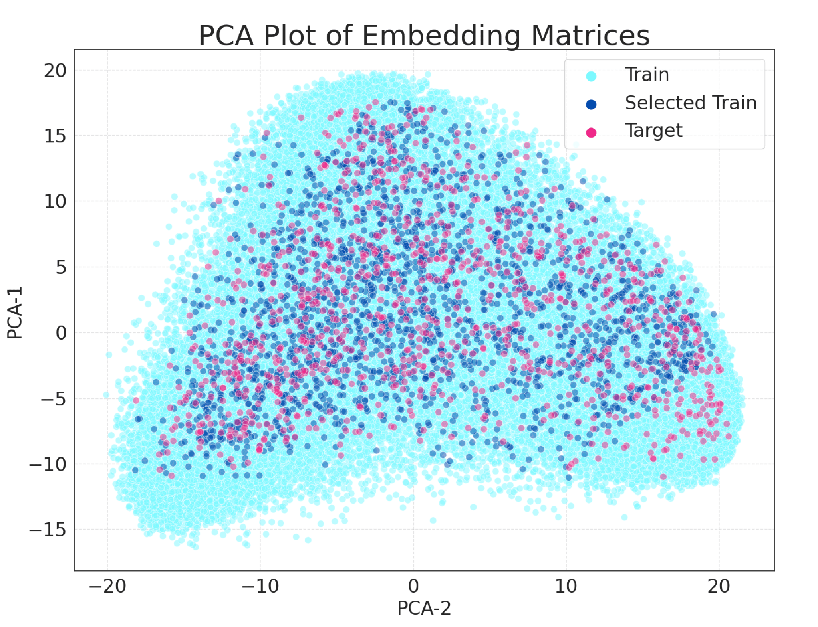
Visualization of strategies: 3-label classification
Average Distance
Representation based strategy that picks points having a minimum average distance w/ the
unlabelled target pool.
Uncertainty
Chooses points that the
model would potentially misclassify in the current AL iteration.
KNN- Uncertainty Select the most uncertain points from the union of top-k neighbors

Slide 15
Setup
Q1) Does DeMuX benefit tasks with varying complexity? Which strategies work well across different task types?
Q2) How well does DeMuX perform across a varied set of target languages? Can it benefit multilingual target pools as well?
Q3) How do the benefits of DeMuX vary across different multilingual LMs?
Dataset | Single Target |  |  | Multi-Target
 | High-perf. | Mid-perf. | Low-perf. | Geo Pool | Low-Performing Pool
UDPOS | French | Turkish | Urdu | Telugu, Marathi, Urdu | Arabic, Hebrew, Japanese, Korean, Chinese, Persian, Tamil, Vietnamese, Urdu
NER | French | Turkish | Urdu | Indonesian, Malay, Vietnamese | Arabic, Indonesian, Malay, Hebrew, Japanese, Kazakh, Malay, Tamil, Telugu, Thai, Yoruba, Chinese, Urdu
XNLI | French | Turkish | Urdu | Bulgarian, Greek, Turkish | Arabic, Thai, Swahili, Urdu, Hindi
TyDiQA | Finnish | Arabic | Bengali | Bengali, Telugu | Swahili, Bengali, Korean

Slide 16
Overall takeaways
Q1) How does DeMuX perform overall?
beats best performing baselines in 84% of the cases
Q2) How does DeMuX fare on multilingual target pools?
gains over baseline, but smaller on average than single target
Q3) Does the model select data from the same languages across tasks?
No, eg.: for Urdu, data chosen from Hindi for NLI/POS; and Farsi/Arabic (script similarity) for NER.
Q4) Which strategies work well across different task types?
Token-level: KNN-UNCERTAINTY
Sequence-level: AVERAGE-DIST and UNCERTAINTY
Question Answering: UNCERTAINTY

Slide 17
Overall takeaways
Q5) What is the minimum budget for which we can observe gains in one AL round?
Gains of up to 8-11 F1 points for token-level tasks, and 2-5 F1 points for NLI and QA
Gains diminish as the budget increases
Q6) Do the selected data points matter or does following the language distribution suffice?
performance declines when you replace selected data points with random data points while following the language distribution of selected points.
For detailed results on all tasks and models, please refer to the paper!

Slide 18
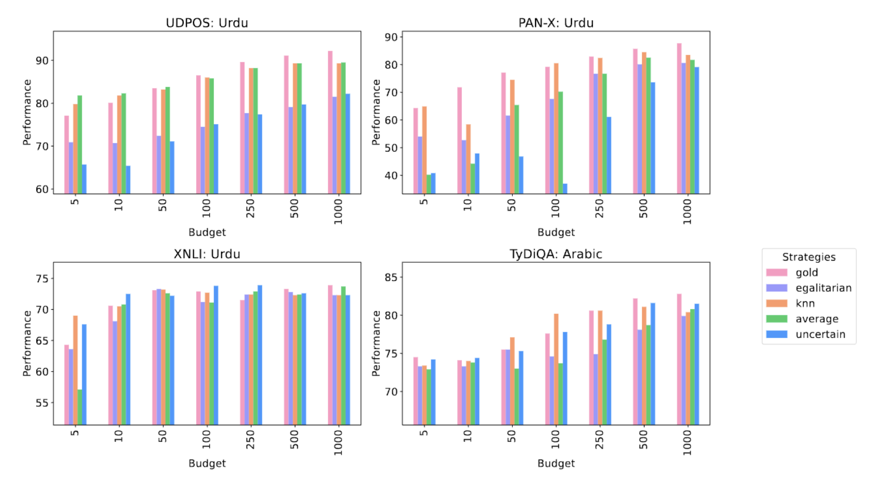
Detailed Results – multiple budgets, one round

Slide 19
Bonus (post-submission)
Extension to generation tasks like MT (supported in github repo)
Test on languages unseen in pre-training yield positive results
[Below] Testing MuRIL on Afrikaans (seen script) and Bulgarian (unscreen script but characters present in vocab file)
Target | Top-3 langs selected by DeMuX | Egalitarian F1 (baseline) | DeMuX F1 (KNN-Uncertainty)
Afrikaans | German:28%, Estonian:19%, Finnish:13% | 77.0 | 78.1
Bulgarian | Russian:81%, Greek:4.8%, Georgian:3.4% | 39.9 | 51.9

Slide 20
Thanks! Please feel free to reach out to skhanuja@andrew.cmu.edu to follow up! Paper: https://arxiv.org/pdf/2311.06379 Code: https://github.com/simran-khanuja/demux
Paper
Code

Slide 21
Problem Statement: A Story

Slide 22
Problem Statement: A Story

Slide 23
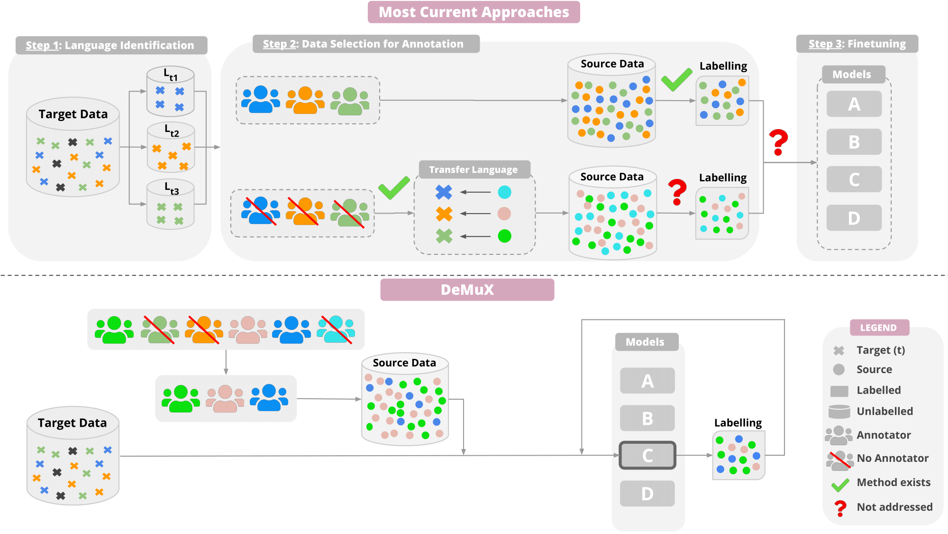
Current pipeline and proposed approach

Slide 24
Results and Discussion
Q1) How does DEMUX perform overall?
Best-performing strategies outperform best performing baselines in 92% of the cases
Variable gains dependant on the task, model and target languages
Q2) How does DEMUX fare on multilingual target pools?
Gains consistent across multilingual target pools.
Hypothesized to be enabled by the language-agnostic design of our strategies, which makes annotation decisions at a per-instance level.
Q3) Does the model select data from the same languages across tasks?
No! Varies across tasks for the same language.
Example: When target is Urdu, most data chosen from Hindi for NLI and POS; and Farsi/Arabic (script similarity) for NER.

Slide 25
Experimental Setup
Q1) Does DeMuX benefit tasks with varying complexity? Which strategies work well across different task types?
Q2) How well does DeMuX perform across a varied set of target languages? Can it benefit multilingual target pools as well?
Five target language settings:
Single target (3): High, mid, and low performing languages
Multiple targets (2): Geographically proximal and low-performing languages
Q3) How do the benefits of DeMuX vary across different multilingual LMs?
Three models: XLM-R, InfoXLM, RemBERT

Slide 26
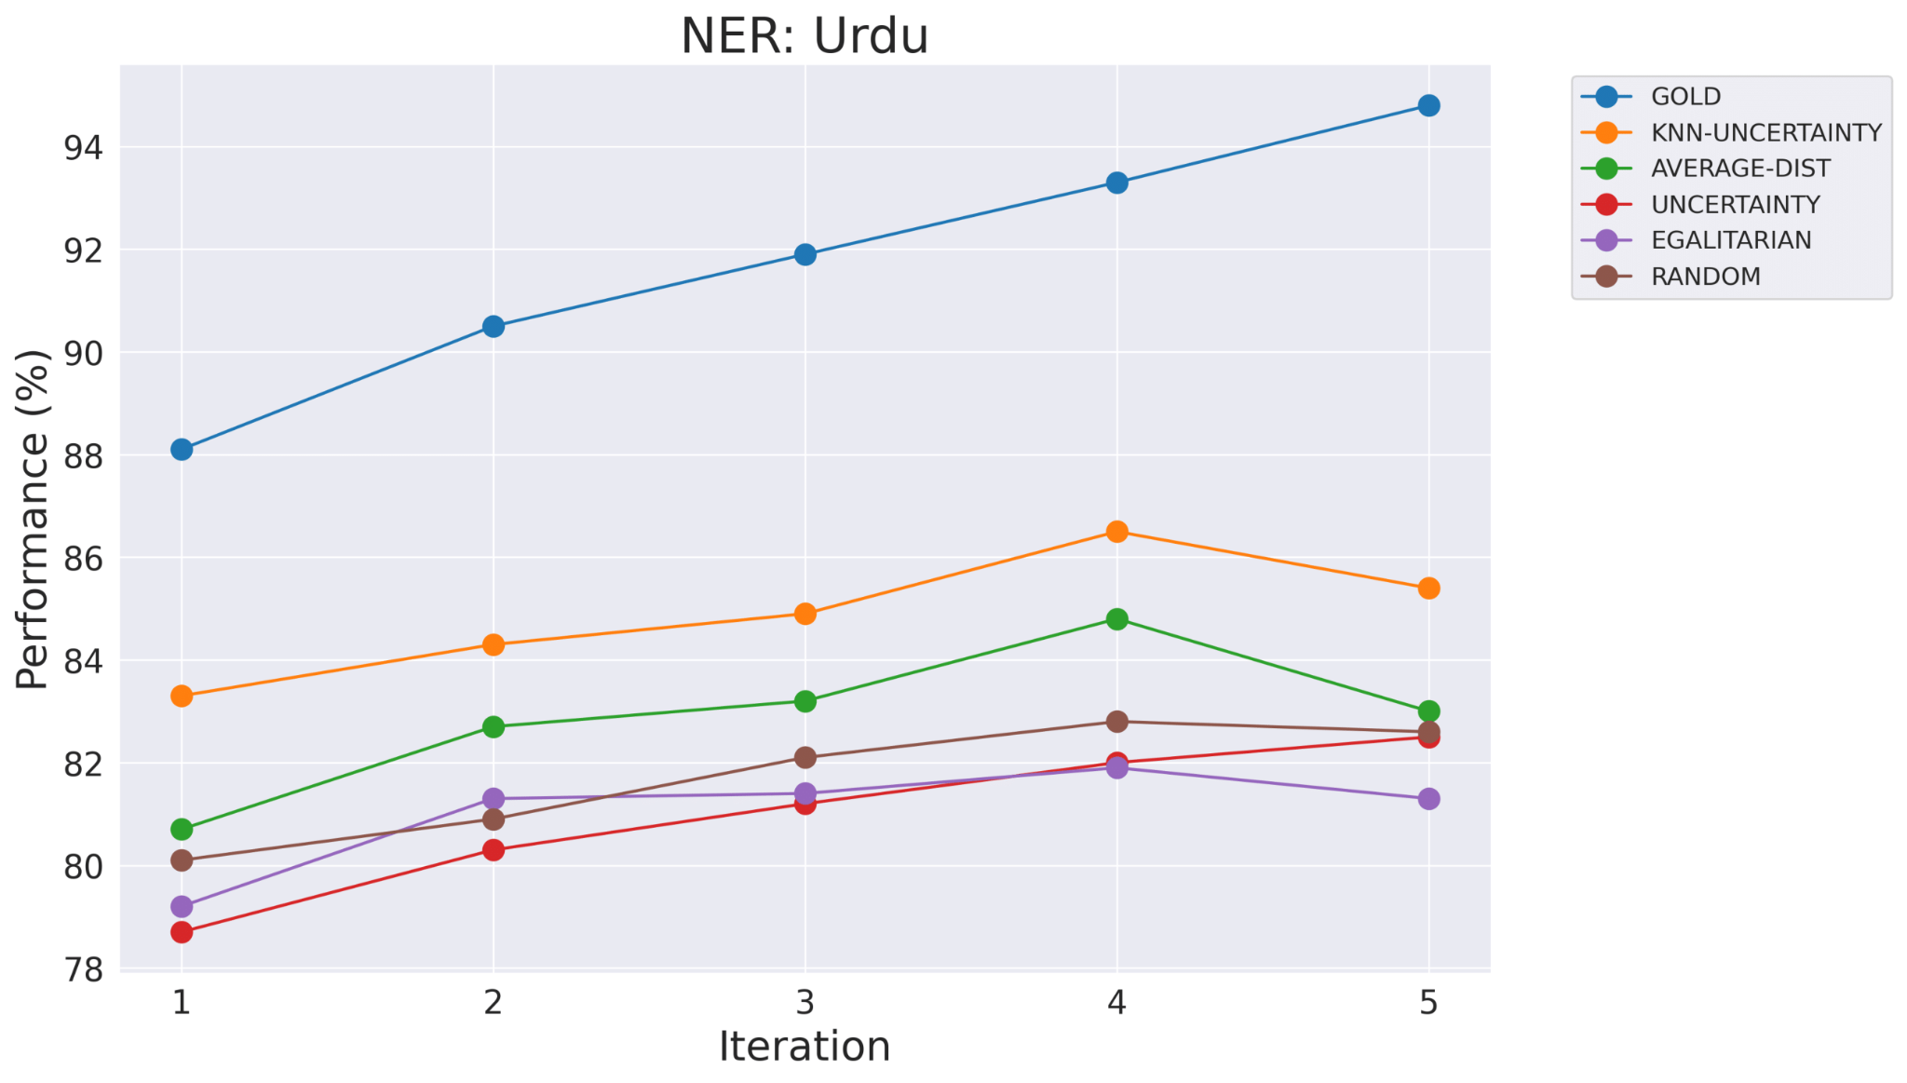
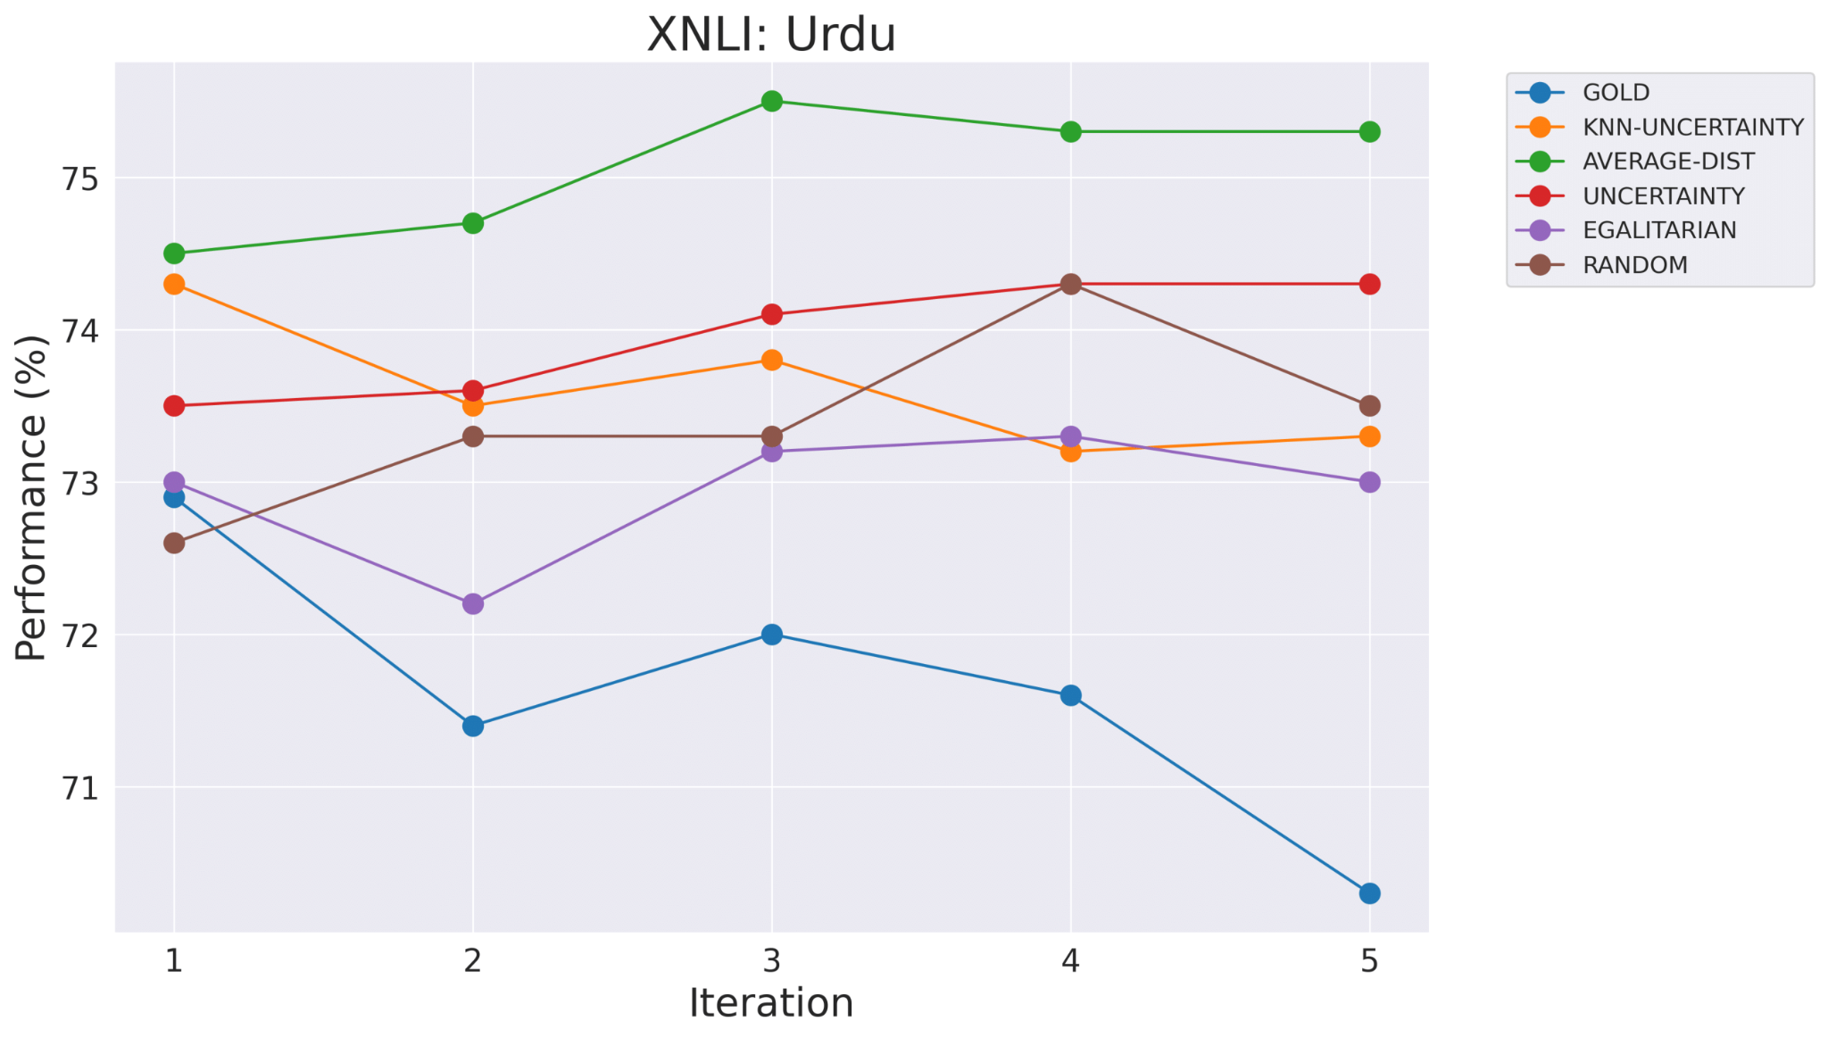
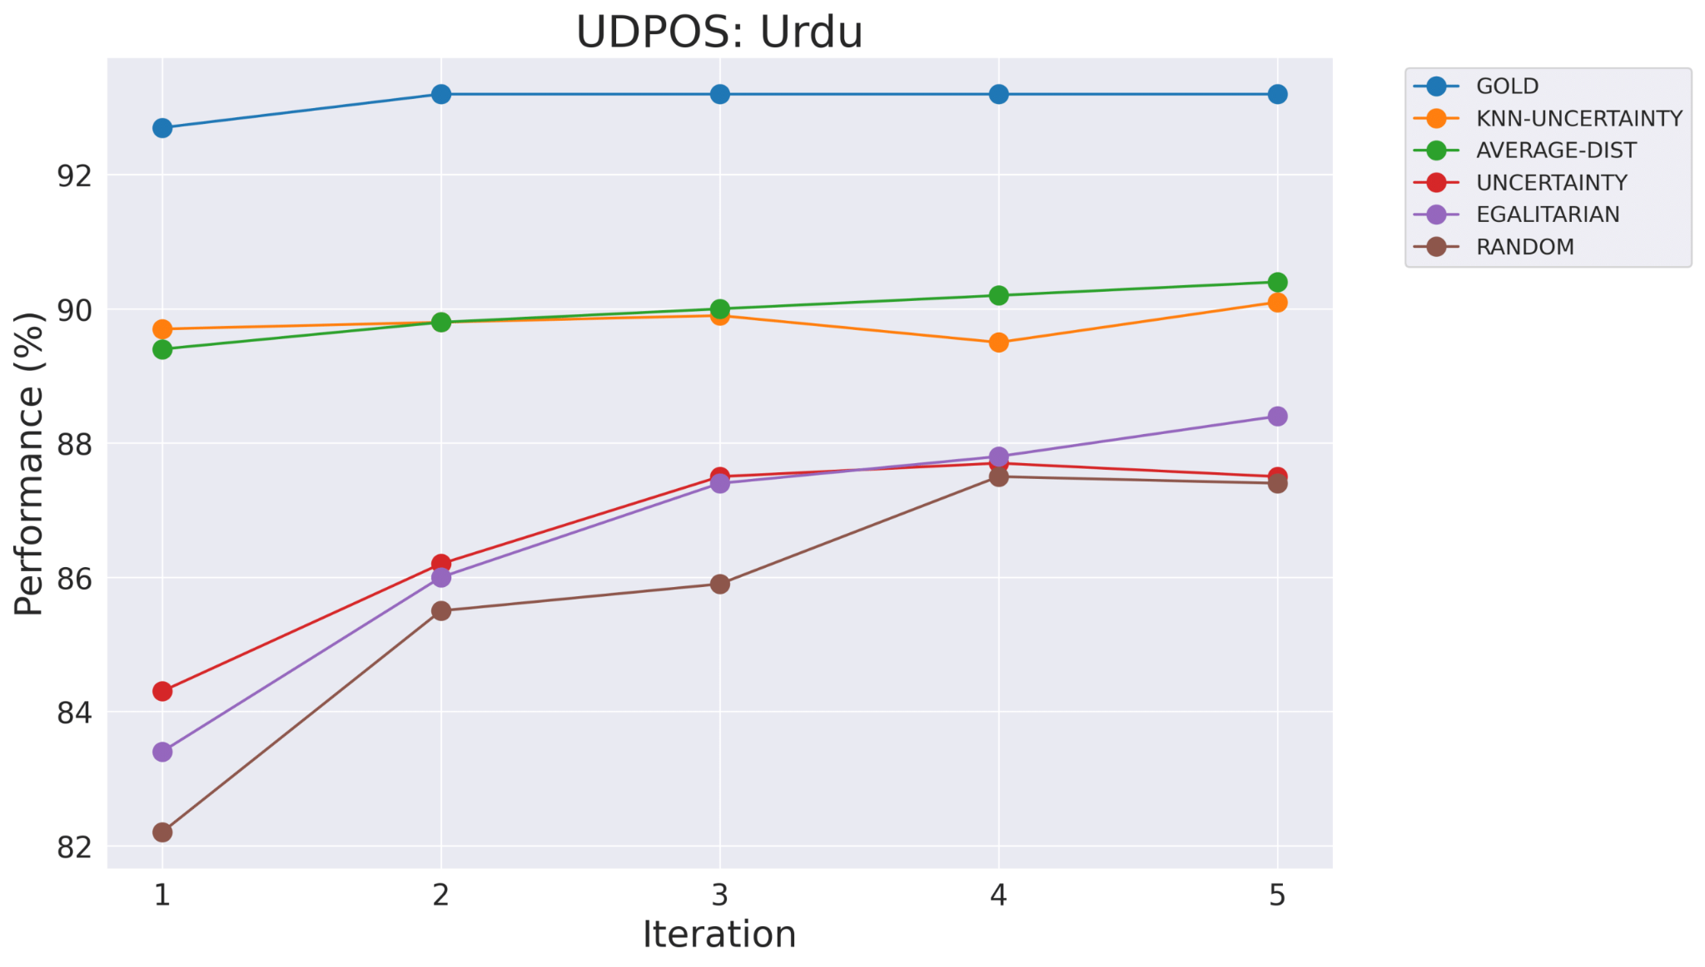
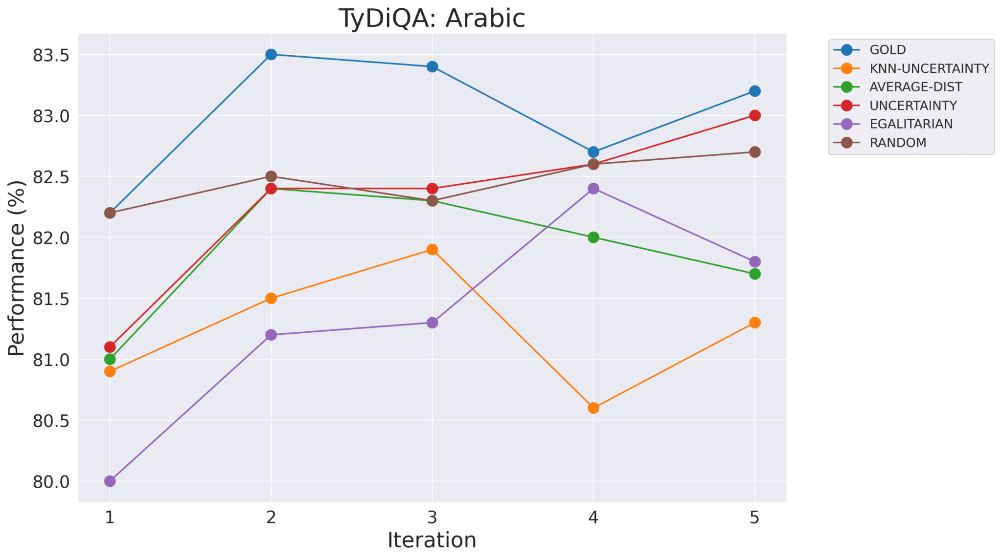
Visualization of results across AL rounds

Slide 27
Results and Discussion
Q1) How does DEMUX perform overall?
Best-performing strategies outperform best performing baselines in 92% of the cases
Variable gains dependant on the task, model and target languages
Q2) How does DEMUX fare on multilingual target pools?
Gains consistent across multilingual target pools.
Hypothesized to be enabled by the language-agnostic design of our strategies, which makes annotation decisions at a per-instance level.
Q3) Does the model select data from the same languages across tasks?
No! Varies across tasks for the same language.
Example: When target is Urdu, most data chosen from Hindi for NLI and POS; and Farsi/Arabic (script similarity) for NER.

Slide 28
Results and Discussion
Q4) Which strategies work well across different task types?
Token-level tasks: KNN-UNCERTAINTY
Sequence-level tasks: AVERAGE-DIST and UNCERTAINTY
Question Answering: UNCERTAINTY
Q5) What is the minimum budget for which we can observe gains in one AL round?
5,10,50,100,250,500,1000 acquired using the EN-FT model only.
Gains of up to 8-11 F1 points for token-level tasks, and 2-5 F1 points for NLI and QA
Gains diminish as the budget increases
Q6) Do the selected data points matter or does following the language distribution suffice?
DeMuX not only identifies transfer languages but also selects specific data for labeling.
Establish language distribution of data selected, replace with randomly selected points following language distribution — performance declines

Slide 29
Problem Statement: A Story
Hindi
Hindi
Bengali
Bengali
Tamil
Tamil
Marathi
Marathi
Kannada
Kannada
❓
UNK
UNK
UNK
UNK
Logo generated using DALL-E 3

Slide 30
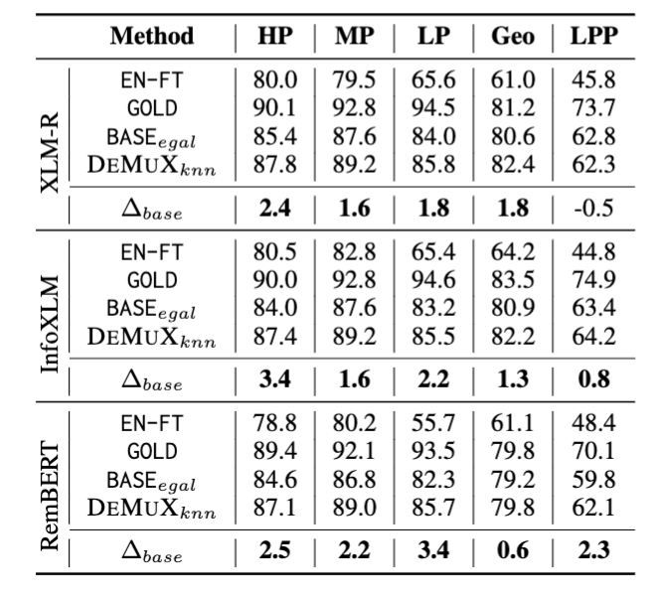
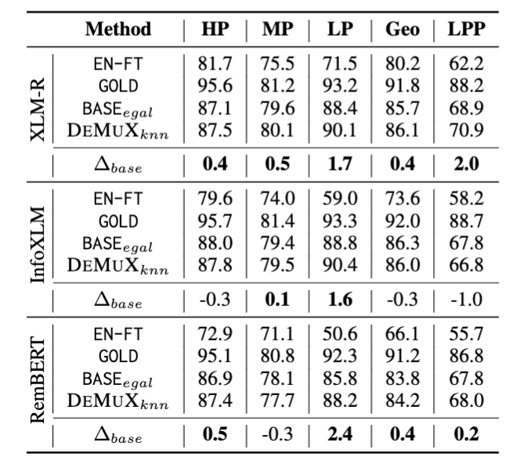
Detailed Results – NER and POS
Named Entity Recognition
Part-of-speech tagging

Slide 31
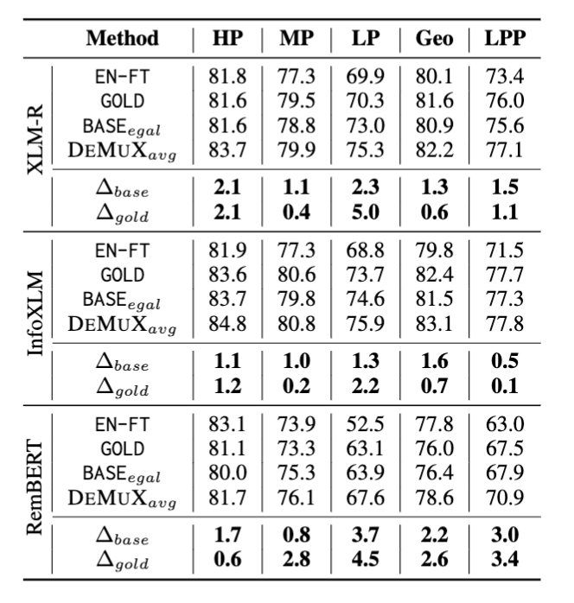
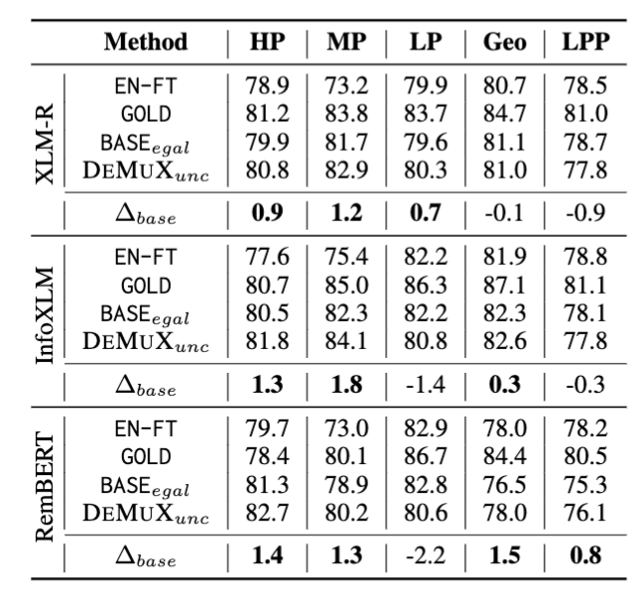
Detailed Results – XNLI & TyDiQA
Cross-lingual NLI
Question Answering

